Slide 1
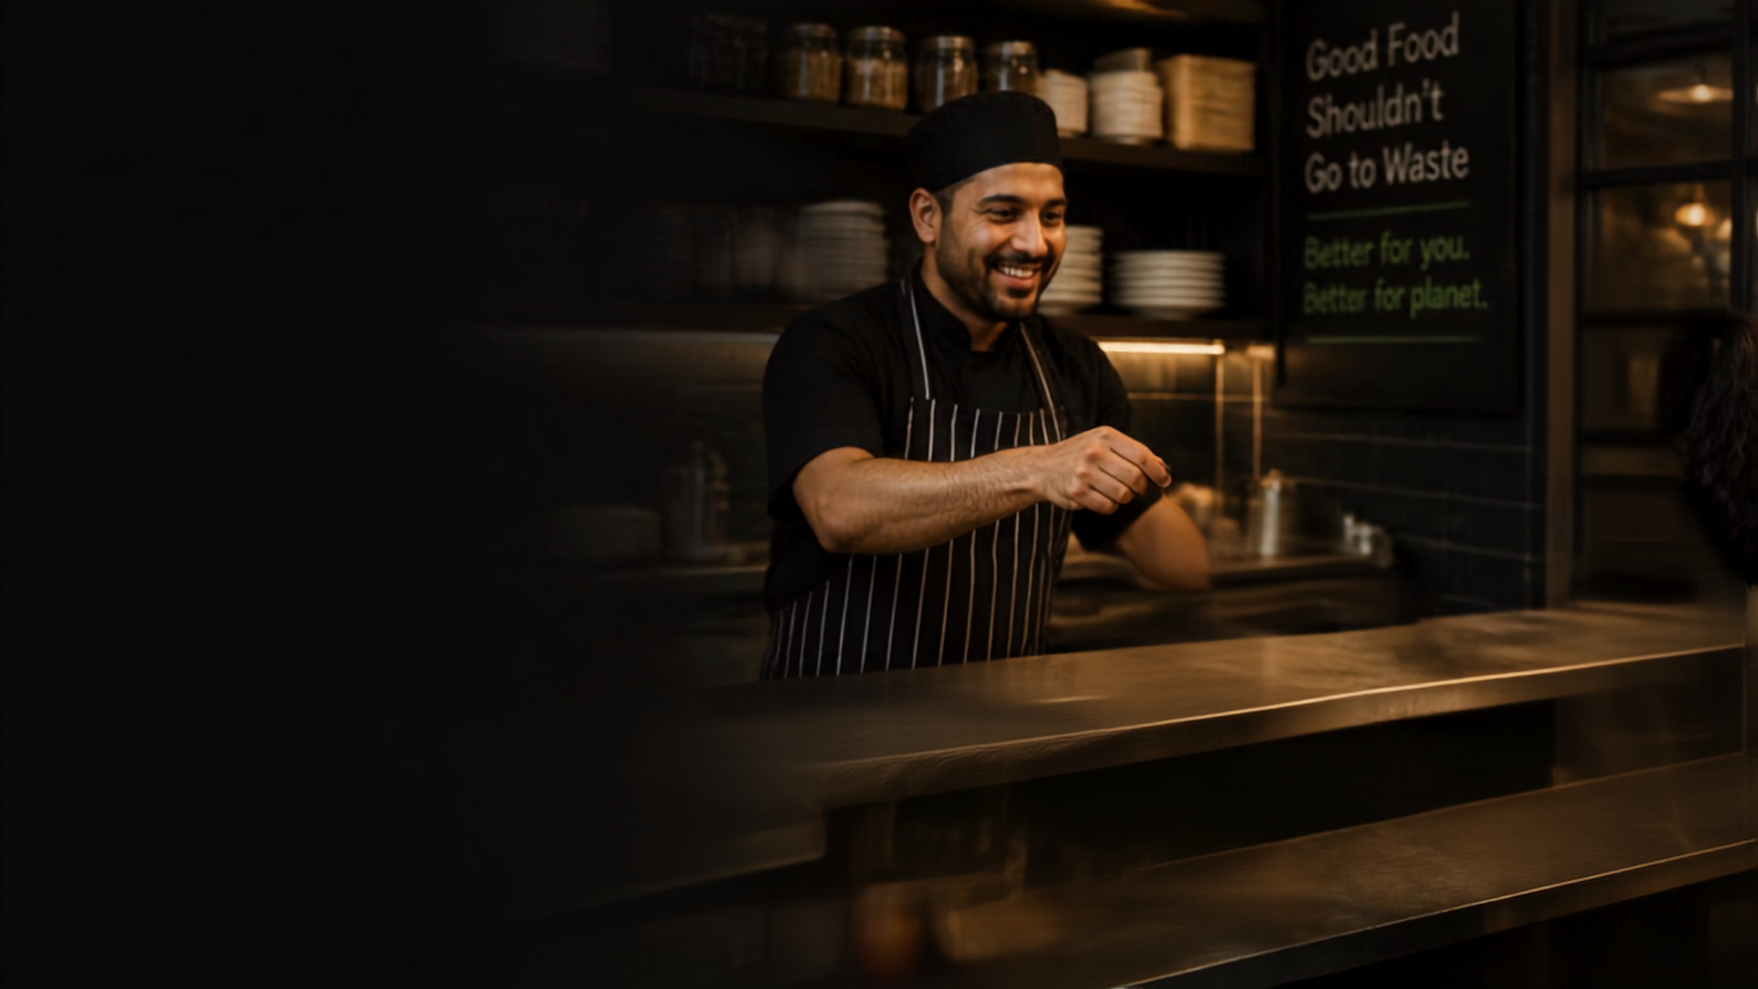



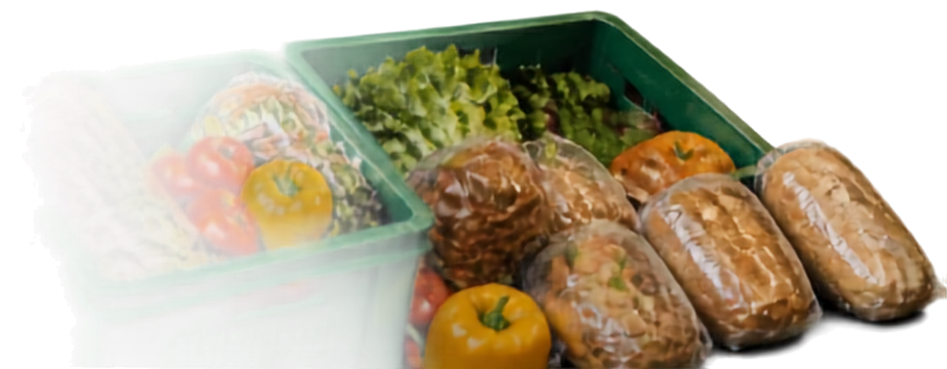
SAVORA
Save Food. Save Money. Reduce Waste.
Food Rescue & Sustainable Food
Ordering Platform
Full Stack Development + AI/ML Project
TEAM MEMBERS
Ruchit Chovatiya — 2648518
Kuldip Gohel — 2648520
Pratixa Jayani --- 2648524
Varun Pawar --- 2648538

Slide 2

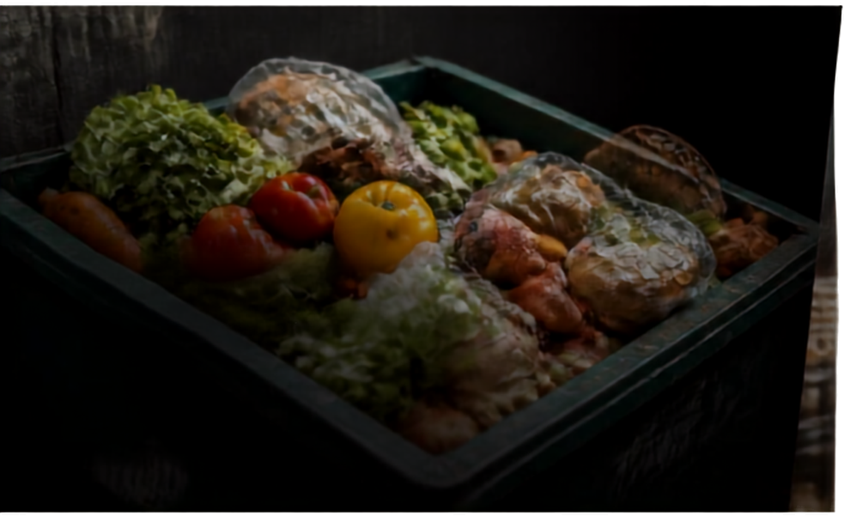
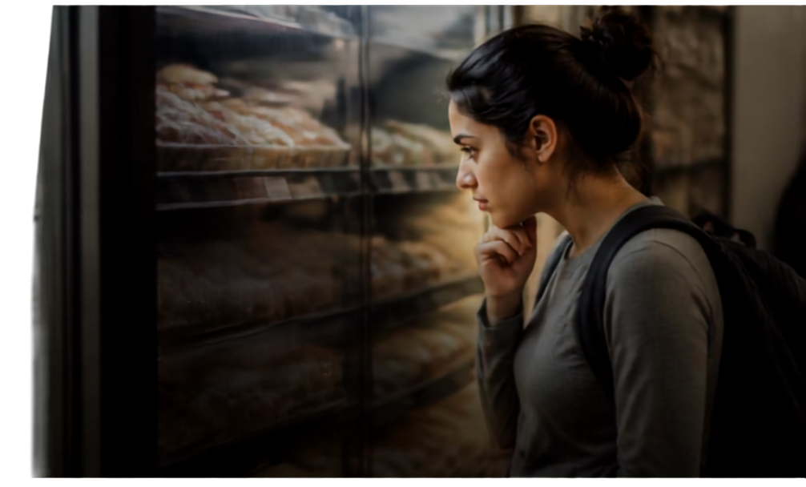

The Problem
We Are Solving
Food waste on one side. Affordability gap on the other.
Food businesses
Customers
Surplus food goes unsold
and to waste
Lost value
Higher environmental impact
Need affordable food
No easy way to find
surplus options
Affordability gap persists
Food waste meets affordability. That's the opportunity for SAVORA.

Slide 3

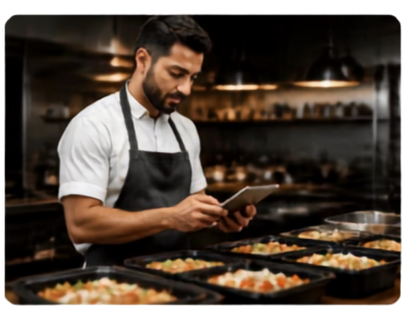
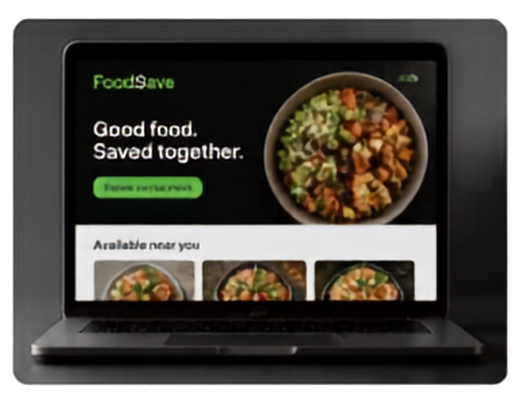



Introducing
SAVORA
Connecting restaurants with customers for food rescue.
SAVORA
Good food. Saved together.
Browse party meals
Available near you
Restaurant
SAVORA Platform
Customer
List surplus meals at discounted prices
Connects surplus food with people who want it
Discover, compare, and order discounted surplus meals
Less waste. More value. Better future. That’s SAVORA.

Slide 4









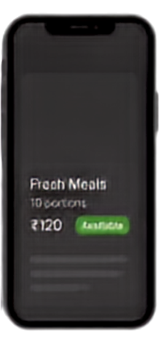
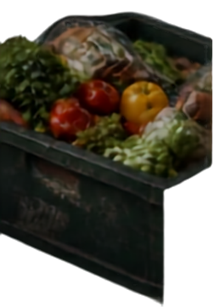

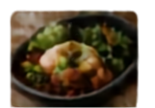

How SAVORA
Works
From listing to order completion
01
02
03
04
05
06
07
08
Restaurant lists food
Adds quantity, price, details
SAVORA publishes listing
Customer discovers & filters
Customer checks details
AI recommends options
Customer places order
Pickup / delivery
Add Listing
SAVORA
Search
Recommended for you
Near me
IT Will show how much KM the Distance is
Quantity
10
Price
₹120
Details
Fresh meals
best before today
Fresh Meals
Chole Bhuture
₹100
Order placed successfully
Fresh Meals
10 portions
₹120
10 portions
Pav bhaji
₹90
₹120
Available
Best before
Today
Order ID
Pickup
2.1 km
#FS9821
Restaurant
Green Bowl
Dosa
₹110

Slide 5

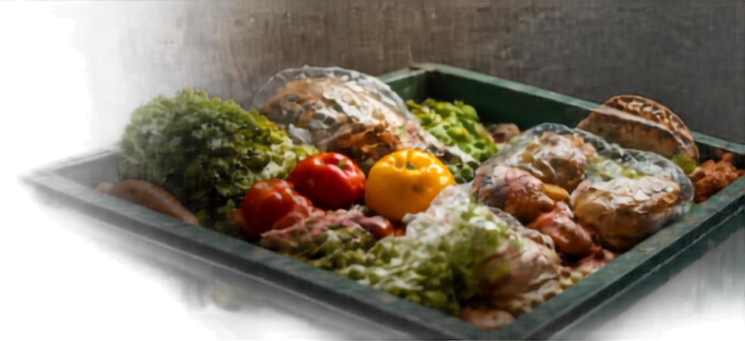



Key Features
Comprehensive features for customers, restaurants, and admin
CUSTOMERS
RESTAURANTS / HOTELS
ADMIN
Search & filter food
Add surplus food
& set discounts
User, restaurant,
& listing management
Discounted prices & food details
Best-before info, ingredients/allergens
Manage orders
& availability
Monitor orders, reports,
& complaints
Personalized recommendations
Sales analytics
& AI insights
Food-rescue analytics
Ordering & payment, ratings & reviews

Slide 6






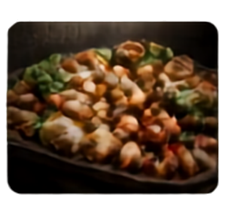



Where AI/ML Makes
SAVORA Smarter
Demand Prediction
Forecasts surplus and demand to reduce waste.
Restaurant Data
Customer Data
Personalized Recommendation
Matches users with food options they’ll love.
AI
Dynamic Discount Recommendation
Suggests the right discounts, at the right time.
Inventory
Preferences
Food Demand Analysis
Surplus
Purchase History
Uncovers trends to guide smarter decisions.
Pricing
Location
Availability
Engagement
Availability-Time Prioritization
History
Feedback
Prioritizes what to list, when it matters most.
Customer Behaviour Analysis
Smarter Outcomes
Learns patterns to improve experience and impact.
Less Waste
More Savings
Happier Customers
Stronger Impact

Slide 7














Our “Strange”
AI Requirement
Order increase by optimized timing and discount
+68%
AI-Discovered Insight Driving Better Food Rescue
AI finds meaningful patterns beyond programmed rules.
MORE ORDERS
168
Surplus meals listed between 7:00 PM and 8:00 PM with 30–40% discounts get significantly more orders than similar meals listed later.
01
02
03
04
05
Data
AI Analysis
Pattern
Better Recommendations
Increased Food Rescur
Surplus listings across time, discounts, and orders
Detects patterns beyond human observation
Baseline
Optimized Timing & Discount
Prime time listings with 30–40% discounts drive more orders
Optimize listing time and discount strategy
More orders, less waste, greater impact
Orders indexed (Baseline = 100)

Slide 8















Technology &
Customer / Restaurant
Users and food businesses
System Architecture
Support Services
Frontend
Full-Stack Architecture Overview
React.js / HTML / CSS / JS
Authentication
A smart, scalable platform that connects surplus food with people who need it.
Backend API
Payment Processing
Python (Flask/FastAPI/Django)
Database
Maps / Location Services
MySQL / MongoDB
REST APIs
AI/ML Engine
Python + Pandas + NumPy + Scikit-learn
Admin Dashboard
Recommendations, Predictions, Analytics
Smarter matches, better impact

Slide 9






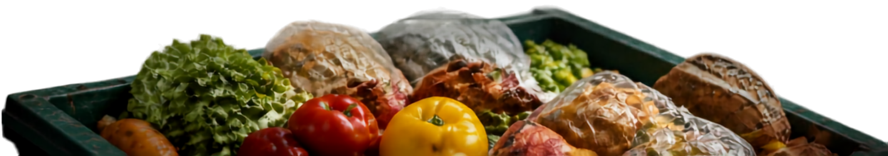
Impact of
SAVORA
CUSTOMERS
RESTAURANTS
SOCIETY & ENVIRONMENT
Affordable meals & discounts
Reduce food waste
Reduce food waste
More choices & transparent info
Recover revenue
Promote sustainable consumption
Personalized recommendations
Reach price-sensitive customers
Better resource use
Understand surplus patterns
LESS WASTE
LOWER COST
BETTER REVENUE
SUSTAINABILITY

Slide 10



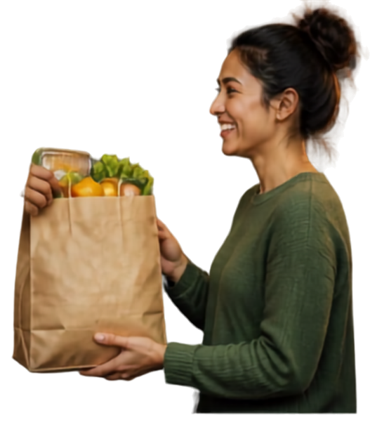

Future Scope &
Conclusion
Building a smarter, more sustainable future.
AI-powered demand forecasting
Smart inventory prediction
Food donation & NGO integration
Carbon-footprint estimation
Mobile app & multi-city expansion
SAVORA connects surplus food with people who value it, combining Full Stack Development + AI/ML + Business Value + Sustainability.
Final thought
“Don’t waste food that someone can still value.”

